Slide 1
Chem B, Unit 8 Day 2
Kinetic Theory of Gases

Slide 2
Kinetic Theory of Gases
A set of assumptions about the behavior of gases that allow us to study them mathematically.
Gases do not live up to these expectations, but they are often “close enough” that these assumptions work well for us.
We’ll talk about the math later this week and get into the gases that really don’t follow the rules next week.

Slide 3
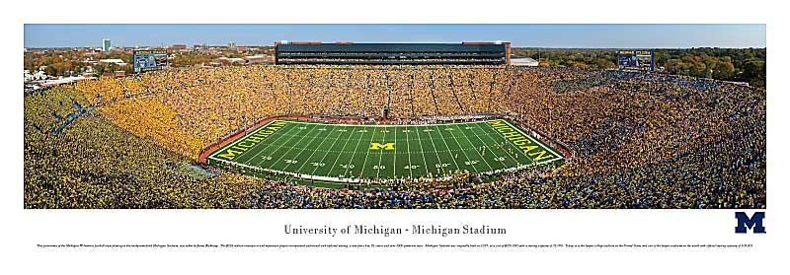
Assumption 1:
Gases consist of very small particles that are far apart relative to their size.
Marbles in a football field.
They don’t collide very much with each other or with the walls.

Slide 4
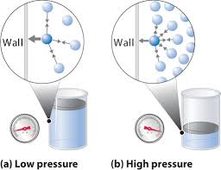
Assumption 2:
Gases are in constant, random motion.
They constantly collide with each other and the walls of the container.
The force exerted by the gas particles on the walls of the container is known as gas pressure.

Slide 5
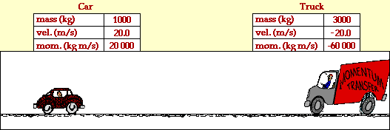
Assumption 3:
Collisions between molecules or molecules and the container walls are elastic.
No energy is lost in the collision.

Slide 6
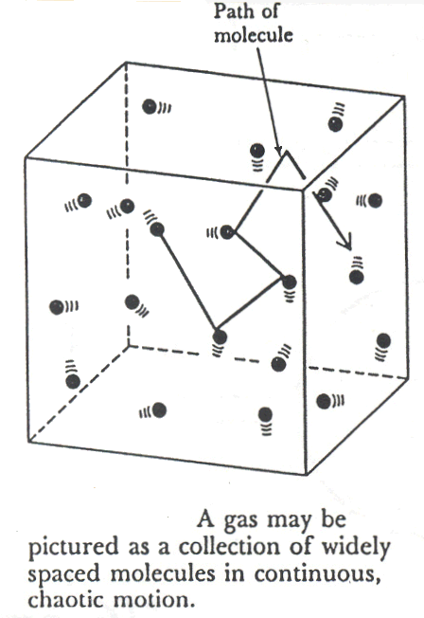
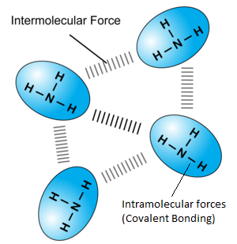
Assumption 4:
There are no forces of attraction or repulsion between gas molecules.
No IMFs!!!

Slide 7
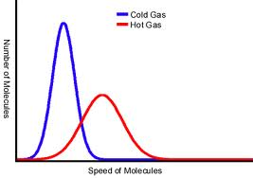
Assumption 5:
The temperature of the gas is depend on the average kinetic energy of the gas particles.

Slide 8
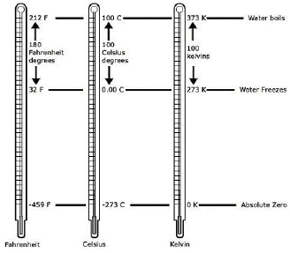
Kelvins

Slide 9
The Nature of liquids and Solids
Unit 8 Day 2

Slide 10
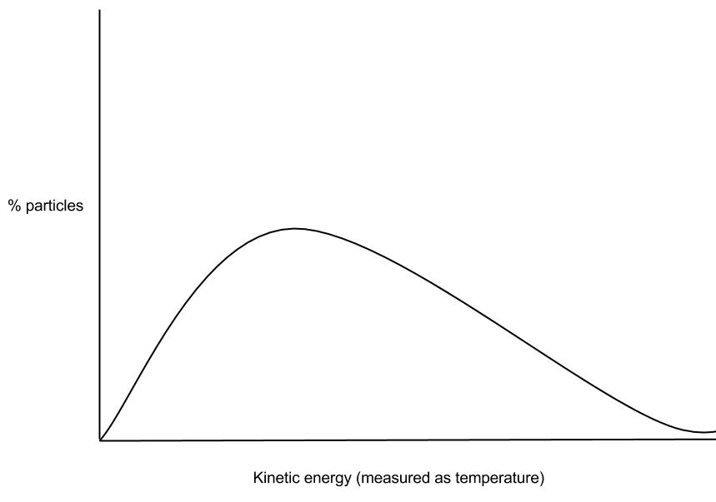
The maxwell boltzmann distribution
Describes the energy range of the particles in a system. Some are moving more slowly than others. Those that are moving faster will hit the walls of the container more often or be able to transition to higher states of energy.
Compounds with more IMFs will have lower KE because they are less free to move.
https://www.youtube.com/watch?v=AOFCSTsLjQY

Slide 11
Liquids
Some Characteristics of Liquids and the Microscopic Explanation for the Behavior
 | assumes the shape of the part of the container which it occupies particles can move/slide past one another
 | not easily compressible little free space between particles
 | flows easily particles can move/slide past one another

Slide 12
Evaporation and boiling Explained
Unit 8, Day 4: Phase change

Slide 13
Vapor Pressure explained
Evaporation of liquids and the boiling of liquids depends in the vapor pressure of the liquid.
Vapor pressure describes the number of liquid molecules that have escaped the liquid phase and move as gas molecules “above the liquid”

Slide 14
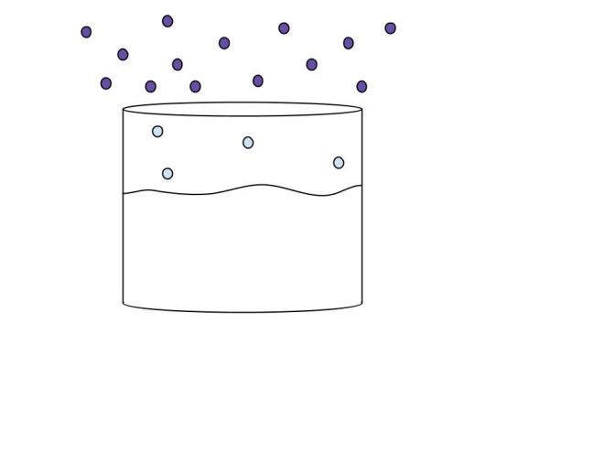
Evaporation
C

Slide 15
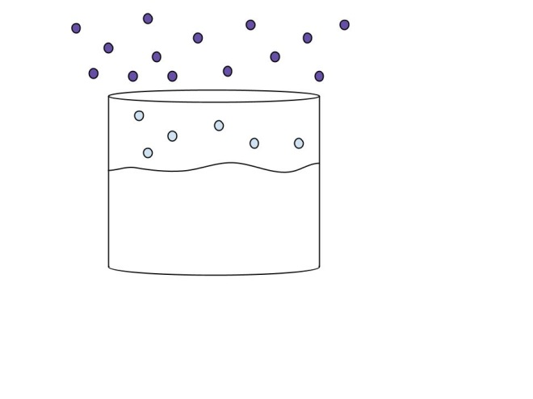
Evaporation
F

Slide 16
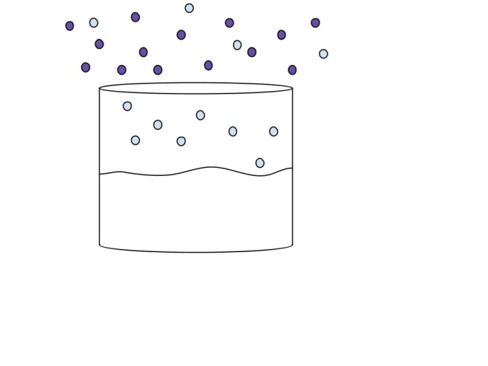
Evaporation
D

Slide 17
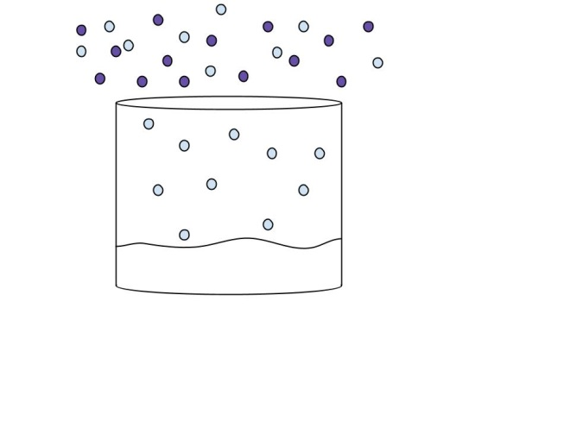
Evaporation
B

Slide 18
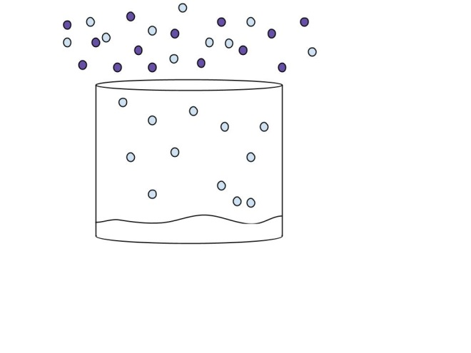
evaporation
G

Slide 19
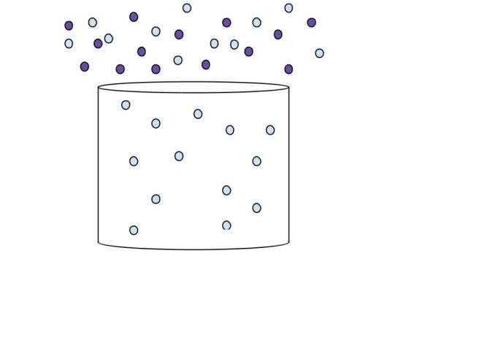
Evaporation
E

Slide 20
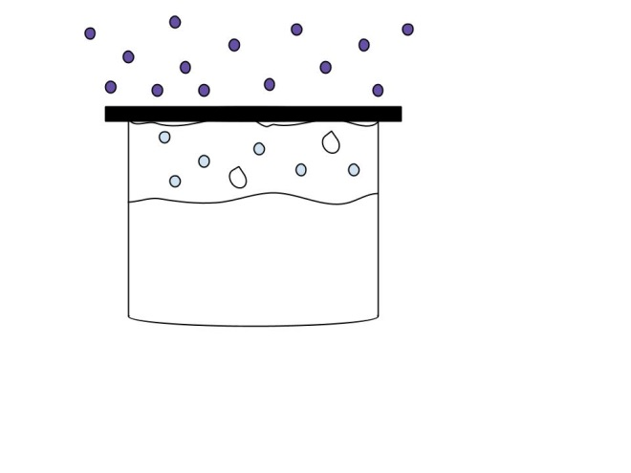
Evaporation in a closed System
B

Slide 21
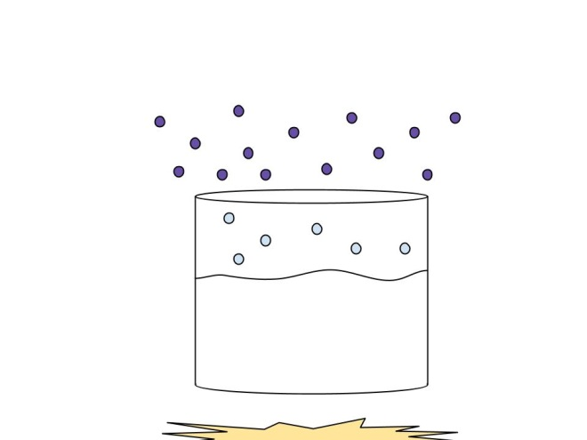
boiling
E

Slide 22
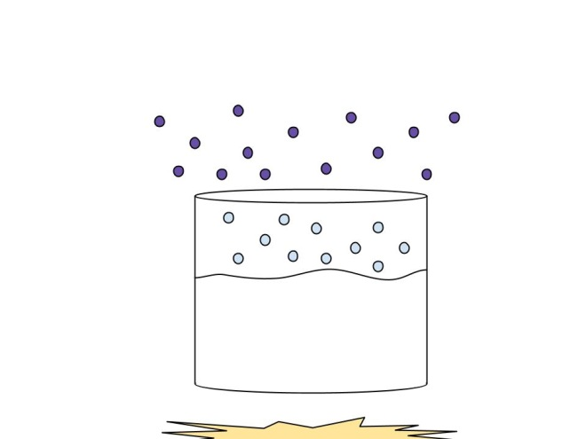
Boiling
H

Slide 23
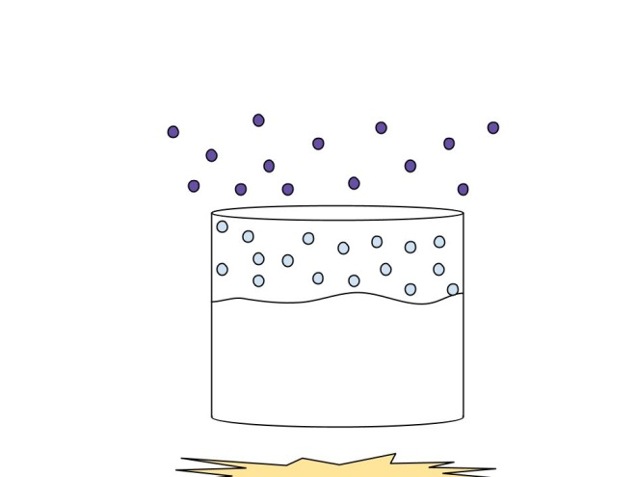
Boiling
The boiling point is the temperature at which the vapor pressure of a liquid equals the external pressure surrounding the liquid.
B

Slide 24
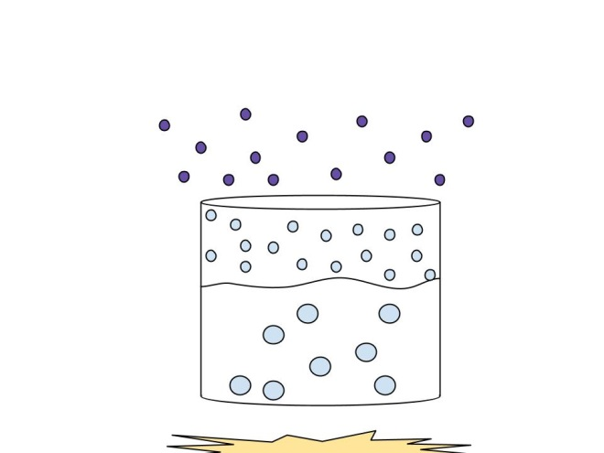
Boiling
D

Slide 25
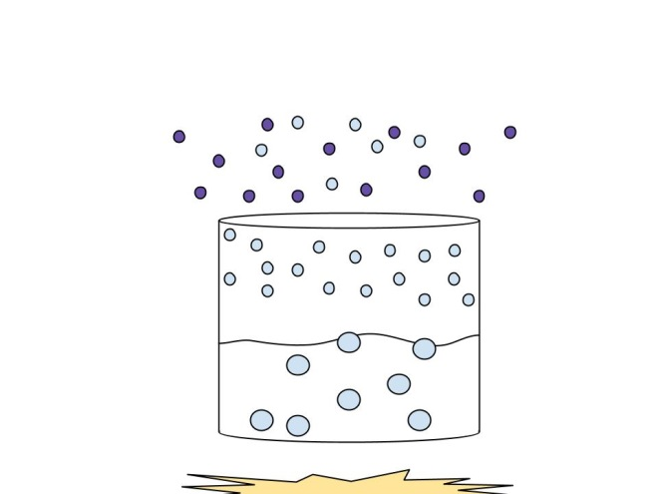
Boiling
C

Slide 26
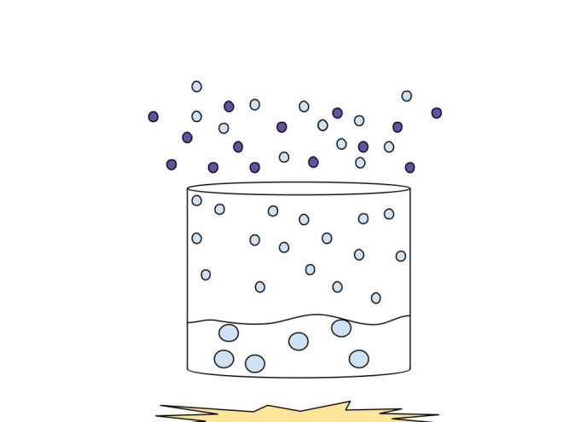
Boiling
A

Slide 27
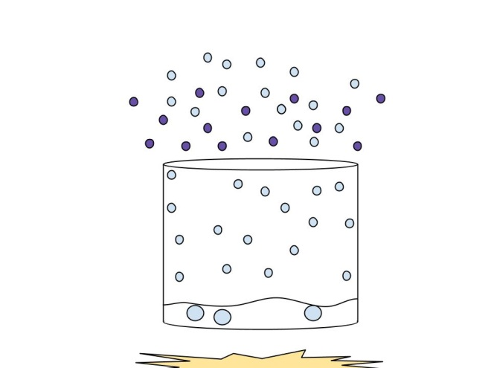
Boiling
G

Slide 28
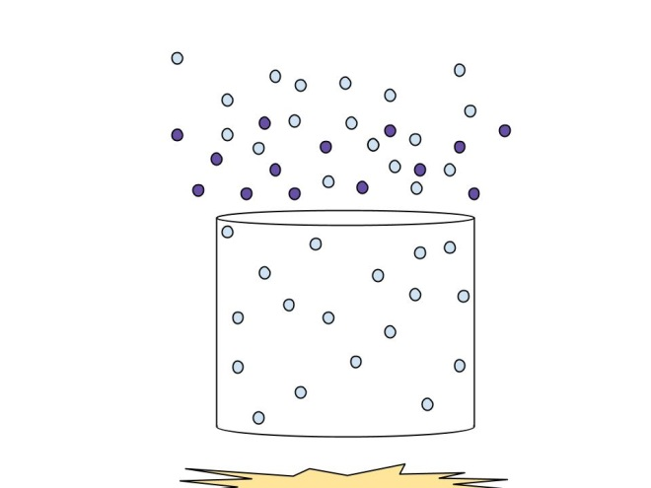
boiling
F

Slide 29
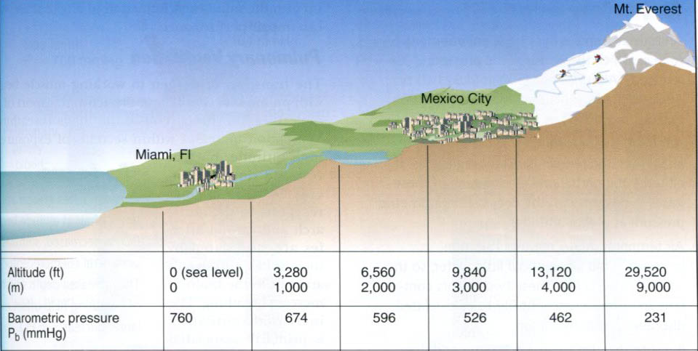
Changing pressure
The boiling point of a liquid depends on atmospheric pressure. The boiling point becomes lower as the external pressure is reduced.

Slide 30
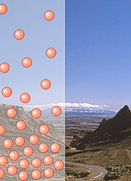
Atmospheric pressure
As altitude increases, the atmospheric pressure decreases.
What happens to the boiling point of water as you go to higher altitudes? To lower altitudes?

Slide 31
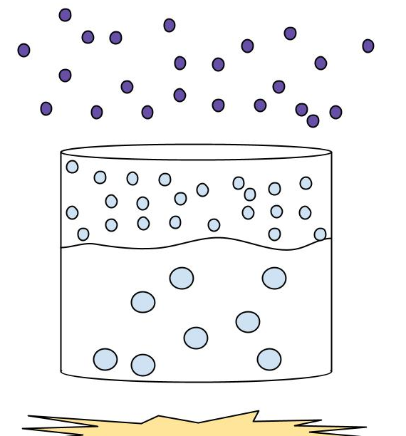
Atmospheric pressure
a
Altitude (height above sea level)
b
Answer: b. The water will boil at a higher temperature than 100°C at low altitudes (more KE needed to vaporize liquid). This concept is used in pressure cookers, which cook the food faster, by increasing of the “atmospheric pressure” above the liquid.

Slide 32
Atmospheric pressure
a
Altitude (height above sea level)
b
Answer: a. The water will boil at a temperature lower than 100°C at high altitudes (less KE needed to vaporize enough water to equal atmospheric pressure). Because the water is cooler when it boils, directions on cake mixes and mac ‘n cheese boxes tell you to cook the food for _______ .

Slide 33
Boiling Temperatures of liquids at different pressures

Slide 34
Phase Changes
Chem B, Unit 8, day 4
THE DAY’S TASKS:
Revisit evaporation and boiling of liquids.
Heating curve of a substance.
Phase diagram of a substance.
Previewing tomorrow’s lab.

Slide 35
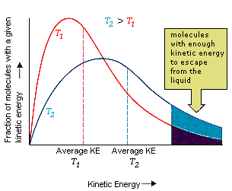
Liquid molecules Escaping to the gas Phase.

Slide 36
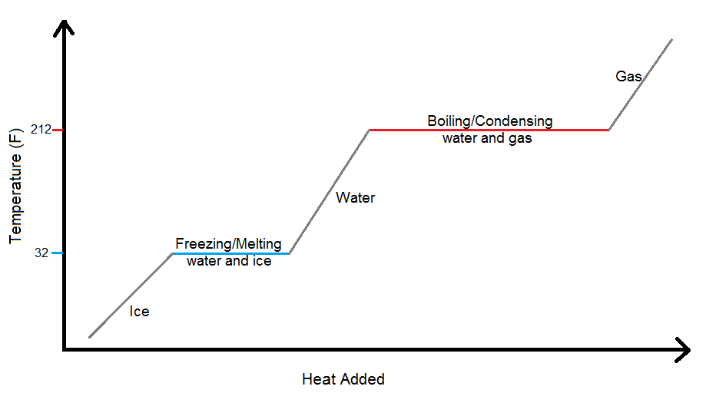
Heating Curve

Slide 37
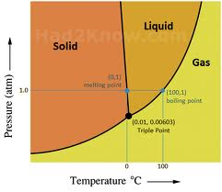
Phase Change Diagram

Slide 38
announcements
We are going to be doing an exploration lab tomorrow.
WEAR CLOSE-TOED SHOES.
Quiz for this chapter is due Friday, 5/9, 9 pm. This will be emailed to you.
Homework check on Thursday during lab.
Earning additional lab passes: 90 minutes of study time in the chemistry classroom will earn you an additional lab pass. Those who have already spent time in the classroom will have their time prorated.

Slide 39
Ideal Gas Law
Unit 8, Day 7: Getting a Snapshot

Slide 40
Bellwork A: Recall the Assumptions of KMT
Gases consist of very small particles that are far apart relative to their size.
Gases are in constant, random motion. They constantly collide with each other and the walls of the container.
Collisions between molecules or molecules and the container walls are elastic.
There are no forces of attraction or repulsion between gas molecules.
The temperature of the gas is depend on the average kinetic energy of the gas particles.
These assumptions describe the characteristics of ideal gases.

Slide 41
Bellwork B: Combined Gas Law
If a gas occupies 13.5 L at 273 K and 1.00 atm, what volume would the gas occupy if the temperature is raised to 298 K and the pressure is reduced to 0.50 atm?
$\frac{P_{1}V_{1}}{n_{1}T_{1}}=\frac{P_{2}V_{2}}{n_{2}T_{2}}$
V₁ = 13.5 L V₂ = ?
T₁ = 273 K T₂ = 298 K
P₁ = 1 atm P₂ = 0.50 atm
n₁ = n₂ (cancel these!)
$$\frac{(13.5 L)(1 atm)}{273 K}=\frac{V_{2}(0.50 atm)}{298 K}$$
$$\frac{(13.5 L)(1 atm)(298K)}{(273 K)(0.50 atm)}=V_{2}$$
V₂ = 29 L

Slide 42
Ideal Gas Law
If you know the values for P, V, T, and n for one set of conditions, you can calculate a value for the ideal gas constant (R).
P × V
R =
T × n

Slide 43
Ideal Gas Law
If you know the values for P, V, T, and n for one set of conditions, you can calculate a value for the ideal gas constant (R).
P × V
Recall that 1 mol of every gas occupies 22.4 L at STP (101.3 kPa and 273 K).
Insert the values of P, V, T, and n into (P × V)/(T × n).
R =
T × n

Slide 44
Ideal Gas Law
If you know the values for P, V, T, and n for one set of conditions, you can calculate a value for the ideal gas constant (R).
P × V
101.3 kPa × 22.4 L
R =
=
T × n
273 K × 1 mol
R = 8.31 (L·kPa)/(K·mol)

Slide 45
Ideal Gas Law
The gas law that includes all four variables—P, V, T, n—is called the ideal gas law.
P × V = n × R × T
or
PV = nRT

Slide 46
R is the gas constant
Units are dependent upon units of P, V, & n.
T must always be expressed as absolute temperature (K).
n is usually expressed in moles
Units for V and P are usually liters and atm or kPa.

Slide 47
STP
1atm & 0ºC
Standard temperature and pressure.
T= 0°C (273.15K) & 1 atm.
Molar volume of an ideal gas at STP:
22.41 L

Slide 48
The ideal gas equation does not always accurately describe gas behavior.
Usually the difference between the ideal value and the real value is so small that we can ignore variations.

Slide 49
Calcium carbonate decomposes upon heating to give calcium oxide and CO₂ gas. A sample of calcium carbonate is decomposed and the carbon dioxide is collected in a 250mL flask. The gas has a pressure of 1.3atm. at 31°C. How many moles of CO₂ were generated?
A) 127 moles
B) .128 moles
C) .0130 moles
D) 13.0 moles
E) .000129 moles

Slide 50
0.013 mol of CO₂

Slide 51
A tennis ball has a volume of 144cm³ and contains 0.33 g of nitrogen gas. What is the pressure inside the ball at 24°C?
A) .46 kPa
B) .46 atm
C) 5700 kPa
D) 2.0 atm
E) 202 atm
Notes:
0.33g N₂ 1mol N₂= 0.012mol N₂
28.00 g N₂

Slide 52
Solution
2.0 atm

Slide 53
What is the volume in liters occupied by 49.8 g of HCl at STP?
A) 11.0 L
B) .30 L
C) 31 L
D) 1100 L
Notes:
30.6
2.6

Slide 54
Real Gases
Unit 8, Day 9
The following slides are the product of Pearson.

Slide 55
Ideal Gases and Real Gases
An ideal gas is one that follows the gas laws at all conditions of pressure and temperature.
Its particles could have no volume.

Slide 56
Ideal Gases and Real Gases
An ideal gas is one that follows the gas laws at all conditions of pressure and temperature.
Its particles could have no volume.
There could be no attraction between particles in the gas.

Slide 57
Ideal Gases and Real Gases
There is no gas for which these assumptions are true.
So, an ideal gas does not exist.

Slide 58
Ideal Gases and Real Gases
At many conditions of temperature and pressure, a real gas behaves very much like an ideal gas.

Slide 59
Ideal Gases and Real Gases
At many conditions of temperature and pressure, a real gas behaves very much like an ideal gas.
The particles in a real gas have volume.

Slide 60
Ideal Gases and Real Gases
At many conditions of temperature and pressure, a real gas behaves very much like an ideal gas.
The particles in a real gas have volume.
There are attractions between the particles.

Slide 61
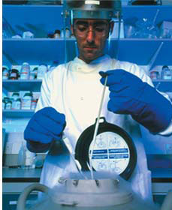
Ideal Gases and Real Gases
At many conditions of temperature and pressure, a real gas behaves very much like an ideal gas.
The particles in a real gas have volume.
There are attractions between the particles.
Because of these attractions, a gas can condense, or even solidify, when it is compressed or cooled.

Slide 62
Ideal Gases and Real Gases
Real gases differ most from an ideal gas at low temperatures and high pressures.

Slide 63
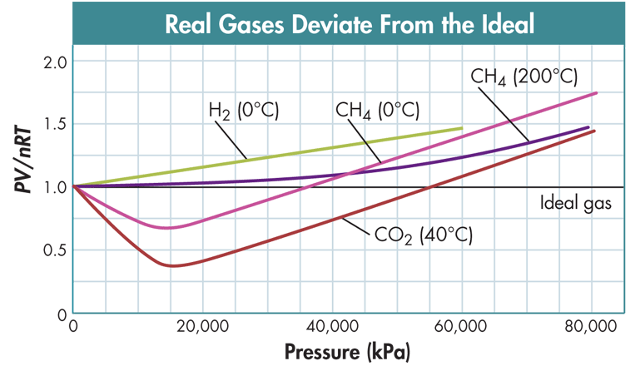
Interpret Graphs
This graph shows how real gases deviate from the ideal gas law at high pressures.

Slide 64
What are the characteristics of an ideal gas?

Slide 65
What are the characteristics of an ideal gas?
The particles of an ideal gas have no volume, and there is no attraction between them.

Slide 66
CHEMISTRY & YOU
Certain types of fog machines use dry ice and water to create stage fog. What phase changes occur when stage fog is made?

Slide 67
CHEMISTRY & YOU
Certain types of fog machines use dry ice and water to create stage fog. What phase changes occur when stage fog is made?
Dry ice doesn’t melt—it sublimes. As solid carbon dioxide changes to gas, water vapor in the air condenses and forms a white fog. Dry ice can exist because gases don’t obey the assumptions of kinetic theory at all conditions.

Slide 68
Key Concepts and Key Equation
When the pressure, volume, and temperature of a contained gas are known, you can use the ideal gas law to calculate the number of moles of the gas.
Real gases differ most from an ideal gas at low temperatures and high pressures.
Key Equation: ideal gas law
P × V = n × R × T or PV = nRT

Slide 69
BIG IDEA
Kinetic Theory
Ideal gases conform to the assumptions of kinetic theory.
The behavior of ideal gases can be predicted by the gas laws.
With the ideal gas law, the number of moles of a gas in a fixed volume at a known temperature and pressure can be calculated.
Although an ideal gas does not exist, real gases behave ideally under a variety of temperature and pressure conditions.

Slide 70
Partial Pressure and Diffusion
Unit 8, Day 9
The following slides are the product of Pearson.

Slide 71
CHEMISTRY & YOU
Why do balloons filled with helium deflate faster than balloons filled with air?
The surface of a latex balloon has tiny pores through which gas particles can pass. The rate at which the balloon deflates depends on the gas it contains.

Slide 72
Dalton’s Law
How is the total pressure of a mixture of gases related to the partial pressures of the component gases?

Slide 73
Dalton’s Law
Gas pressure results from collisions of particles in a gas with an object.
If the number of particles increases in a given volume, more collisions occur.
If the average kinetic energy of the particles increases, more collisions occur.
In both cases, the pressure increases.

Slide 74
Dalton’s Law
Particles in a mixture of gases at the same temperature have the same kinetic energy.
The kind of particle is not important.
The contribution each gas in a mixture makes to the total pressure is called the partial pressure exerted by that gas.

Slide 75
Interpret Data
The total pressure of dry air is the sum of the partial pressures of the component gases.
Composition of Dry Air
Component | Volume (%) | Partial pressure (kPa)
Nitrogen | 78.08 | 79.11
Oxygen | 20.95 | 21.22
Carbon dioxide | 0.04 | 0.04
Argon and others | 0.93 | 0.95
Total | 100.00 | 101.32

Slide 76
Dalton’s Law
In a mixture of gases, the total pressure is the sum of the partial pressures of the gases.
The chemist John Dalton proposed a law to explain this.
Dalton’s law of partial pressures states that, at constant volume and temperature, the total pressure exerted by a mixture of gases is equal to the sum of the partial pressures of the component gases.
P_{total} = P₁ + P₂ + P₃ + …

Slide 77
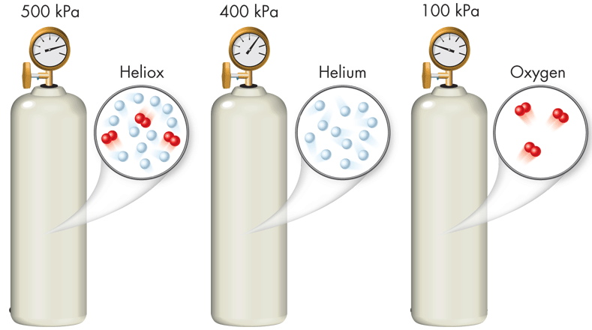
Dalton’s Law
Each component gas exerts its own pressure independent of the pressure exerted by the other gases.
The pressure in the container of heliox (500 kPa) is the same as the sum of the pressures in the containers of helium and oxygen (400 kPa + 100 kPa).

Slide 78
Sample Problem 14.7
Using Dalton’s Law of Partial Pressures
Air contains oxygen, nitrogen, carbon dioxide, and trace amounts of other gases. What is the partial pressure of oxygen (P_{O2}) at 101.30 kPa of total pressure if the partial pressures of nitrogen, carbon dioxide, and other gases are 79.10 kPa, 0.040 kPa, and 0.94 kPa, respectively?

Slide 79
Sample Problem 14.7
1
Analyze List the knowns and the unknown.
Use the equation for Dalton’s law of partial pressures (P_{total} = P_{O2} + P_{N2} + P_{CO2} + P_{others}) to calculate the unknown value (P_{O2}).
KNOWNS
UNKNOWN
P_{N2} = 79.10 kPa
P_{O2} = ? kPa
P_{CO2} = 0.040 kPa
P_{others} = 0.94 kPa
P_{total} = 101.30 kPa

Slide 80
Sample Problem 14.7
2
Calculate Solve for the unknown.
Start with Dalton’s law of partial pressures.
P_{total} = P_{O2} + P_{N2} + P_{CO2} + P_{others}
Rearrange Dalton’s law to isolate P_{O2}.
P_{O2} = P_{total} – (P_{N2} + P_{CO2} + P_{others})

Slide 81
Sample Problem 14.7
2
Calculate Solve for the unknown.
Substitute the values for the total pressure and the known partial pressures, and solve the equation.
P_{O2} = 101.30 kPa – (79.10 kPa + 0.040 kPa + 0.94 kPa)
= 21.22 kPa

Slide 82
Sample Problem 14.7
3
Evaluate Does this result make sense?
The partial pressure of oxygen must be smaller than that of nitrogen because P_{total} is only 101.30 kPa.
The other partial pressures are small, so the calculated answer of 21.22 kPa seems reasonable.

Slide 83
A tank used by scuba divers has a P_{total} of 2.21 × 10⁴ kPa. If P_{N2} is 1.72 × 10⁴ kPa and P_{O2} is 4.641 × 10³ kPa, what is the partial pressure of any other gases in the scuba tank (P_{other})?
Notes:
Please add an answer slide.

Slide 84
A tank used by scuba divers has a P_{total} of 2.21 × 10⁴ kPa. If P_{N2} is 1.72 × 10⁴ kPa and P_{O2} is 4.641 × 10³ kPa, what is the partial pressure of any other gases in the scuba tank (P_{other})?
P_{total} = P_{O2} + P_{N2} + P_{others}
P_{others} = P_{total} – (P_{N2} + P_{O2})
P_{others} = 2.21 × 10⁴ kPa – (1.72 × 10⁴ kPa + 4.641 × 10³ kPa)
P_{others} = 2.59 × 10² kPa

Slide 85
Graham’s Law
Graham’s Law
How does the molar mass of a gas affect the rate at which the gas diffuses or effuses?

Slide 86
Graham’s Law
If you open a perfume bottle in one corner of a room, at some point, a person standing in the opposite corner will be able to smell the perfume.
Molecules in the perfume evaporate and diffuse, or spread out, through the air in the room.

Slide 87
Graham’s Law
Diffusion is the tendency of molecules to move toward areas of lower concentration until the concentration is uniform throughout.

Slide 88
Graham’s Law
During effusion, a gas escapes through a tiny hole in its container.

Slide 89
Graham’s Law
During effusion, a gas escapes through a tiny hole in its container.
With effusion and diffusion, the type of particle is important.

Slide 90
Graham’s Law
Gases of lower molar mass diffuse and effuse faster than gases of higher molar mass.

Slide 91
Graham’s Law
Thomas Graham’s Contribution
Graham’s law of effusion states that the rate of effusion of a gas is inversely proportional to the square root of the gas’s molar mass.
This law can also be applied to the diffusion of gases.
If two objects with different masses have the same kinetic energy, the lighter object must move faster.

Slide 92
CHEMISTRY & YOU
Why do balloons filled with helium deflate faster than balloons filled with air? Use Graham’s law of effusion to explain your answer.

Slide 93
CHEMISTRY & YOU
Why do balloons filled with helium deflate faster than balloons filled with air? Use Graham’s law of effusion to explain your answer.
Molecules of helium have a lower mass than the average mass of air molecules, so helium molecules effuse through the tiny pores in a balloon faster than air molecules do.

Slide 94
Graham’s Law
Comparing Effusion Rates
Suppose you have two balloons, one filled with helium and the other filled with air.
If the balloons are the same temperature, the particles in each balloon have the same average kinetic energy.
But helium atoms are less massive than oxygen or nitrogen molecules.
So the molecules in air move more slowly than helium atoms with the same kinetic energy.

Slide 95
Graham’s Law
Because the rate of effusion is related only to a particle’s speed, Graham’s law can be written as follows for two gases, A and B.
Rate_{A}
molar mass_{B}
=
Rate_{B}
molar mass_{A}

Slide 96
Sample Problem 14.8
Comparing Effusion Rates
How much faster does helium (He) effuse than nitrogen (N₂) at the same temperature?

Slide 97
Sample Problem 14.8
1
Analyze List the knowns and the unknown.
Use Graham’s law and the molar masses of the two gases to calculate the ratio of effusion rates.
KNOWNS
UNKNOWN
molar mass_{He} = 4.0 g
ratio of effusion rates = ?
molar mass_{N2} = 28.0 g

Slide 98
Sample Problem 14.8
2
Calculate Solve for the unknown.
Start with the equation for Graham’s law of effusion.
Rate_{He}
molar mass_{N2}
=
Rate_{N2}
molar mass_{He}

Slide 99
Sample Problem 14.8
2
Calculate Solve for the unknown.
Substitute the molar masses of nitrogen and helium into the equation.
Rate_{He}
28.0 g
=
=
7.0
= 2.7
Rate_{N2}
4.0 g

