Slide 1
Welcome to Chemistry!
Unit 6: Chapter 10 and 11

Slide 2
Day 1 Bellwork
Fill out your 3x5 card with the following information:
Name Year (soph, junior, senior)
Secret Name Birthday
Email address you actually check
Guardian 1 name
Guardian 2 name (star who you live with)
Your book recommendation for me
What you like to do (clubs, sports, hobbies)
Anything I should know (sit up front, ADHD, etc.)

Slide 3
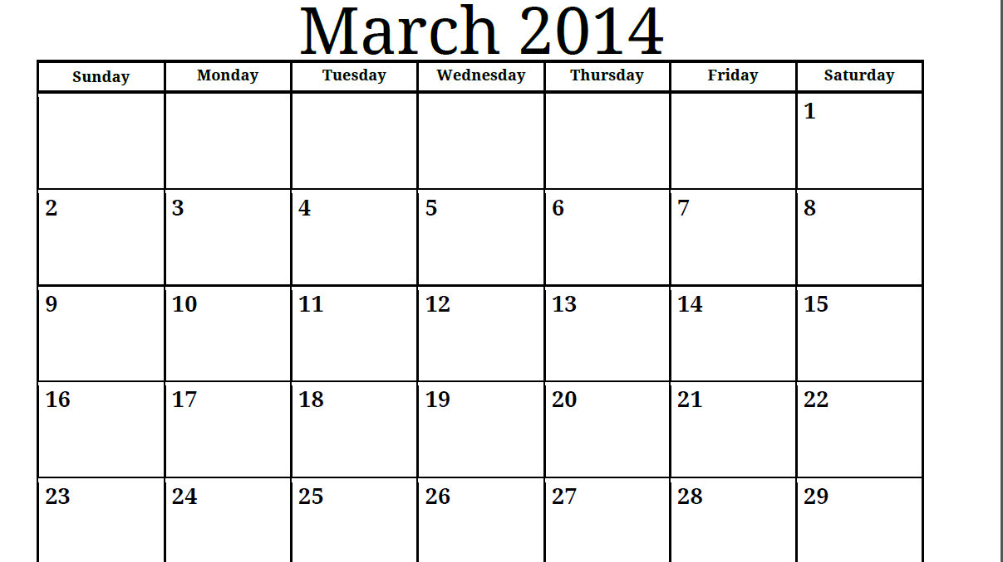
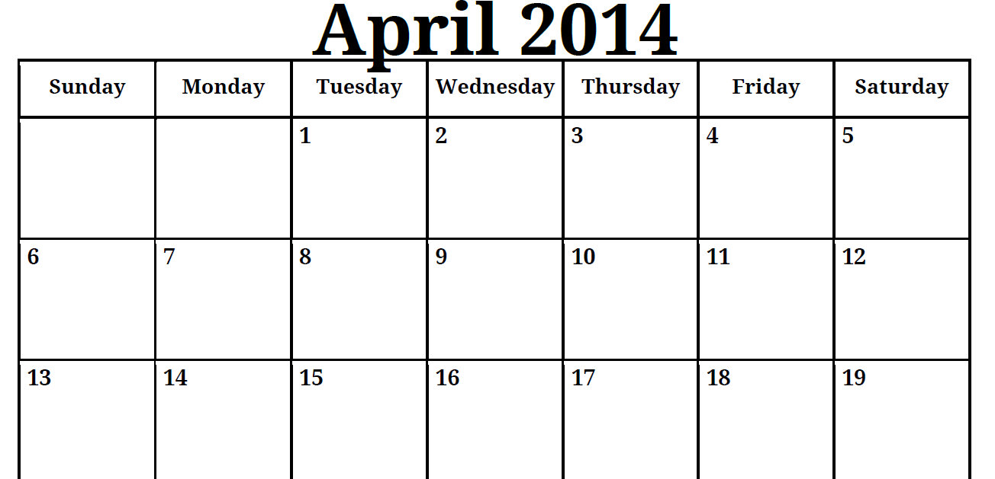
Time table for Unit 6: day 1
Chapter 10
Chapter 10
Chapter 11
Chapter 11

Slide 4
Agenda for the day
8 min: Bellwork
15 min: Introduce Chem B expectations
5 min: Demonstration: Zinc and acid go boom!
10 min: Discuss demonstration (think-pair-share)
25 min: Review Chem A concepts
2 min: Wrap Up and Announcements

Slide 5
Goals
  Class expectations:
    Participation = success
    Don’t be afraid to be wrong
  Course syllabus:
    Gives you a sense of where we’re going, as well as the “how” and the “when.”
    To help you be prepared and organized.
  Homework is for your learning, not for our grading.
  Chemical safety

Slide 6
Lab safety
Skim the Flinn Safey contract.
With your neighbor, identify your top 3 safety practices. Write these down on a separate piece of paper or highlight them on your contract.
Be prepared to share these with the class.

Slide 7
Lab safety continued
Ms P is going to run a demonstration and needs ensure that she (and everyone else) are safe.
What safety tips do you have for her?

Slide 8
Lab notes
Goggles.
Hair needs to be tied back.
Read through the procedures.
Closed-toe shoes.
Cotton clothing and no billowing sleeves.
Never eat or drink in lab.
Acid spill? Base spill?
Emergency?

Slide 9

Naming Review
$${Zn}_{(s)}+{HCl}_{(aq)} →{ZnCl}_{(s)}+H_{2 (g)}$$

Slide 10
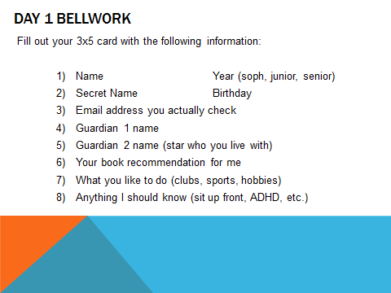
Homework
For tomorrow (Wednesday, 3/19):
  Get documents signed!
  Go to www.chemb.weebly.com to access this week’s survey

Slide 11
Day 2 Bellwork
Name of the following compounds:
P₂O₅
MgF₂
Na₂SO₄
HBr
What is the formula of the following compounds?
Potassium oxide
Sulfur trioxide
Sulfuric acid

Slide 12
Agenda for the day
8 min: Bellwork
15 min: Review naming and charge rules
5 min: Types of measurements small group work
20 min: Factor lab method and calculating molar mass
2 min: Wrap Up and Announcements

Slide 13
Goals
Understand the concept of the mole.
Be able to calculate molar mass of a compound from its formula and the periodic table.
For ionic compounds, which do not consist of individual molecules, the sum of the atomic masses is often referred to as a formula mass.

Slide 14
Naming review
Ionic compounds
Molecular compounds
Acids

Slide 15
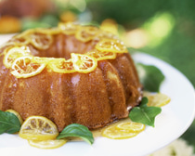
Ingredients in a 7-up pound cake
Ms. P is hosting a family gathering and wants to make a pound cake.
Looking at the list of ingredients, what different types of measurements do you find?
- With a partner, break the ingredients into at least 3 categories of measurements.

Slide 16
Count/set number of individual items | Volume | Mass
5 eggs | 6 mL of lemon extract 3 cups of flour ½ cup shortening | 710 grams flour
1 can of 7-Up | 7 ounces of 7-Up
2 sticks of butter | 1 cup butter | 8 ounces of butter

Slide 17
Types of Measurements
Count: single, dozen, gross, mole
- Measures the number of items/particles you have
Volume: mL, liters, gallons, cups
- Measures the amount of space that that substance takes up
Mass: grams, pounds
- Measures the weight of the substance (gravity dependent).

Slide 18
#1 Convert 1 year to seconds
A.) 525,600 seconds
B.) 1,314,000 s
C.) 9.03 X 10³ s
D.) 31,536,000 seconds
E.) 3,153,600 s
Notes:
d

Slide 19
#2: Convert 52.0 inches to cm
A.) 132 cm
B.) 20.5 cm
C.) 104 cm
D.) not enough info
E.) a lot
Conversion factor: 1 inch = 2.54 cm

Slide 20
Equivalence
1 dozen = ____ eggs
1 ream = ____ eggs
1 gross = ____ eggs
1 mole = _____ eggs
4/16/2014
20
Notes:
20

Slide 21

The Mole
The mole (mol) is strictly a counting unit used for convenience.
A mole is the amount of matter that contains as many atoms as 12g of ¹²C.
6.02214199 x 10²³ particles = 1 mol
1 mol = molecular mass in grams
Notes:
Avogadro’s Number in honor of Amedeo Avogadro (17176-1856)

Slide 22


Molar Mass: the mass of one mole of a substance (grams)
  AKA Gram formula mass (GFM) for ionic compounds.
  Molar mass in grams is numerically equal to the molecular mass amu.

Slide 23
Equivalence
1 atom of C = 12.011 amu
1 mole of C atoms = 6.02 X 10²³ atoms of C
1 mole of C atoms = 12.011 g
1 molecule of water = 18.02 amu
1 mol of H₂O molecules = 6.02 X 10²³ molecules of H₂O
1 mole of water = 18.02 grams

Slide 24
#3: Find the atomic mass of Cu
A.) 29 amu
B.) 63.546 amu
C.) 34 amu
D.) not enough info
E.) IDK
Notes:
b

Slide 25
#4: Find the formula mass of
Copper (II) Nitrate
A.) 60.0 amu
B.) 125.5 amu
C.) 251 amu
D.) 187.6 amu
E.) IDK
Notes:
d

Slide 26
Calculating Masses
Atomic Mass: 1 atom of C = ____ amu
Molar Mass: 1 mole of C atoms = ____ grams
Molecular Mass: 1 molecule of water = ____ amu
Molar Mass: 1 mole of water molecules = _____ grams
Molar Mass: 1 mole of NaCl formulas units = _____ grams
Formula Mass: 1 formula unit = ____ amu (aka Gram Formula Mass)
4/16/2014
26
Notes:
26

Slide 27
Homework
For tomorrow (Thursday, 3/20):
  Go to www.chemb.weebly.com to access this week’s survey.
  Read 10.1

Slide 28
Day 4 Bellwork
1. Using your notes from yesterday, choose the unit that corresponds to each term/phrase:
a.) formula mass
b.) molar mass i.) amu
c.) molecular mass ii.) grams
2. Choose the type of measurement that corresponds to each term/phrase:
a.) grams i.) counting
b.) moles ii.) mass
c.) molar mass iii.) volume

Slide 29
Types of Measurement
Counting Mass Volume
5 eggs
2 sticks butter
1 bottle 7-UP
1 atom, molecule
or formula unit
1 mole
700 grams flour
700 grams sugar
Molecular mass (amu)
Atomic mass (amu)
Formula unit mass (amu)
Molar mass (g)
3 cups flour
6 mL of lemon extract
7 ounces of 7-UP
Molar volume (L)
When working with chemicals,
which of these measurements are most useful?

Slide 30
Road Map: Stoichiometry
molar mass
(g/mole)
Representative particles
(atoms, molecules, formula units)
grams
moles
Avogadro’s number
(6.02x10²³ particles/mole)
molar volume
(22.4L/mole)
liters

Slide 31
#5: Find the molar mass of Sulfuric Acid
A.) 98.1 amu
B.) 97 g
C.) 98.1 g
D.) 34.2 g
E.) 65.6 g
Notes:
c

Slide 32
How many moles of Copper Nitrate are present if there are 1.56 X 10²⁴ formulas units.
4/16/2014
32
Notes:
2.59
32

Slide 33
#6: Convert 2.00 moles of Ag to grams
A.) 108 grams
B.) 94.0 grams
C.) 394 grams
D.) 216 grams
E.) 47 grams
Notes:
d

Slide 34
#7: Convert 20.5 grams of Cu to moles
A.) 1302 moles
B.) .323 moles
C.) .707 moles
D.) 1.23 X 10²⁵ moles
E.) don’t know
Notes:
b

Slide 35
#8: Convert 3.5 grams of Calcium SulFate to formula units
A.) 480 g
B.) 7.9 X 10⁻²² formula units
C.) 1.5 X 10²² formula units
D.) 39 formula units
E.) 2.3 X 10²³ formula units

Slide 36
Percent Composition and Empirical Formulas
Chem B
Unit 1: The mole and
Chemical Reactions
3/24/2014

Slide 37
Day 5: Percent Composition

Slide 38
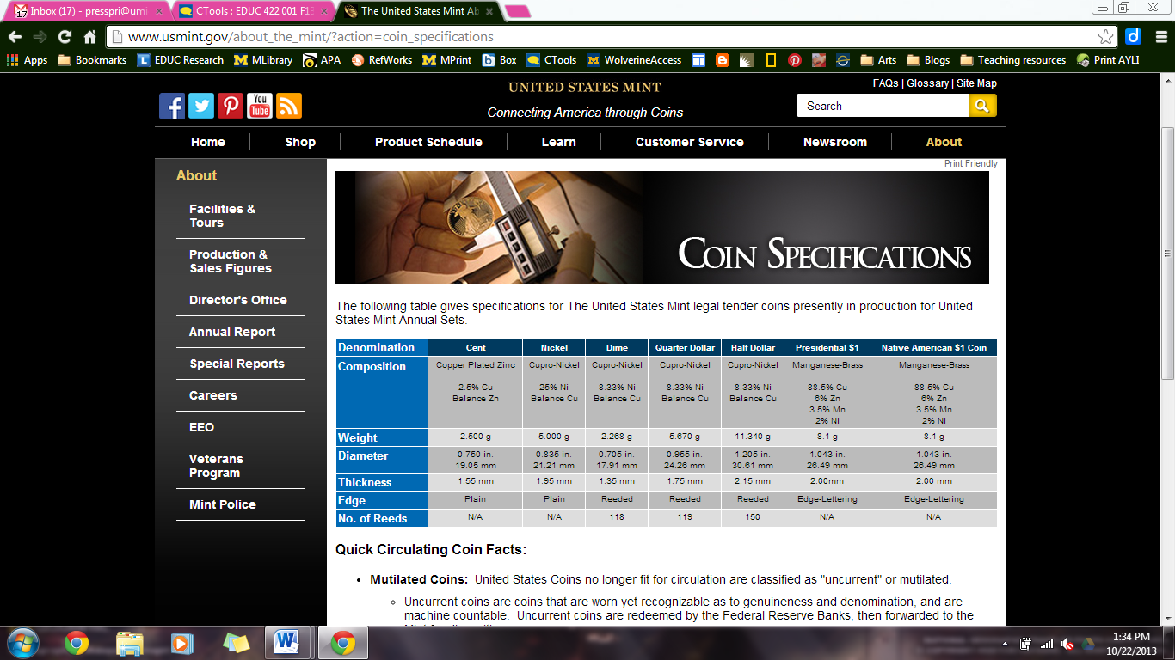
Is one penny worth more than another?
Year of production | Mass of penny (g)
1979 | 3.071
1982 | 3.107
1986 | 2.462
1992 | 2.483
2000 | 2.494
2012 | 2.510
According to the U.S. Mint, every penny is composed of 2.5% Cu.
How much Copper is present in each penny (by mass)?
Derive a general formula for determining the percent composition of an alloy with two elements given their mass.

Slide 39
Percent Composition in chemistry!
Unlike coins, where the amount of each element present has been decided by an engineer, chemicals have “pre-set” amounts that are constant.
Law of Definite Proportions:
  The number of atoms of each element in a molecule is a fixed quantity.
  This means that we will not find NaCl and NaCl₂ present in a batch of table salt.
    Why not?
      The attraction of electrons and nuclei are satisfied through specific chemical bonds in a molecule.

Slide 40
Example: PCl₅
Chemical name?
What does this compound look like?
Mole fraction?
Molar mass?
Percent composition?

Slide 41
Day 6: Empirical Formulas

Slide 42
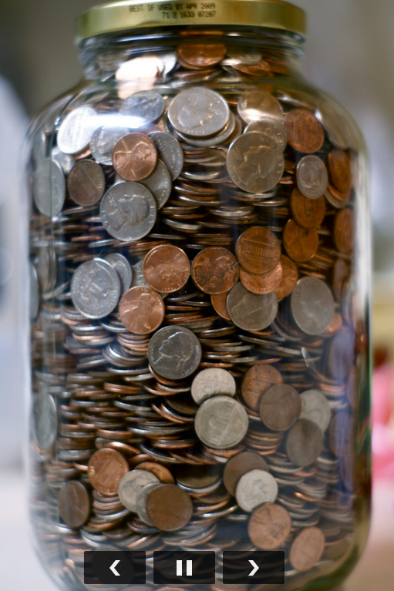
Day 6 Bellwork: Percent Comp and A jar of coins
1. What is the percent composition of
hypochlorous acid?
2. A jar of coins contains 15% quarters,
30% dimes, 20% nickels and
35% pennies:
  What is the ratio of quarters to pennies?
  Of nickels to pennies?
  Write the relationships out like you would
  a chemical formula (Q_{w}D_{x}N_{y}P_{z}).

Slide 43
Total mass vs. relative mass. What’s important?
A jar of coins contains 15% quarters, 30% dimes, 20% nickels and 35% pennies:
Do we need to know the total number of coins to answer this question?
  What about for compounds?
    Given that we have 25% of A and 75% of B in a compound, what is the ratio of A to B?
    How could we write our answer in terms of : A_{x}B_{y}

Slide 44
Empirical Formulas
A chemical formulas that shows the kind of atoms and their relative numbers in the most reduced form.
Ionic compounds are ALWAYS represented with empirical formulas
Molecular Formula: C₂H₆
Empirical Formula of C₂H₆ is ________________
CH₃

Slide 45
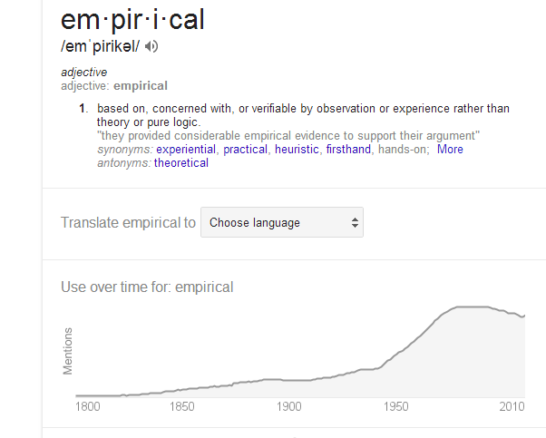
What does it Mean?

Slide 46
Chemical/Empirical Formulas
The subscripts within a chemical formula represent the number of atoms in a molecule or formula unit
The subscripts can represent the number of moles of atoms present in a mole of those molecules or formula units
or

Slide 47
Example
MgO:
1 mole of magnesium to 1 mole of oxygen
Or 1 atom of magnesium to 1 atom of oxygen
CaSO₄
1 mol Ca: 1 mol S: 4 mol O
1 atom Ca: 1 atom S: 4 atom O

Slide 48
Finding Empirical Formulas
Convert % or grams to number of moles
2) Create whole number ratios of moles (Law of Mult. Proportion) by dividing all the moles by the smallest value of moles
  .014 moles versus .007 moles = 2:1
3) If needed multiply by a factor to turn decimals into whole number ratios
  i.e. 1: 1.5 multiply by 2 2:3

Slide 49
LS11) Let’s Figure this out:
What would be the empirical formula of a compound if there is 104.85 grams of Iron and 45.15 grams of oxygen?
A.) FeO B.) Fe₂O C.) Fe₂O₃ D.) Fe₃O₂
Notes:
c

Slide 50
Empirical Formula from analysis
A compound has 73.9 % mercury and 26.1 % chlorine.
What is the empirical formula for this compound?
A.) HgCl B.) Hg₂Cl₂
C.) Hg₄Cl₇ D.) HgCl₂
Notes:
Empirical formula is relative numbers of each element in the compound

Slide 51
HgCl₂
Notes:
Divide each number of moles by the smallest number of moles.
Carbon to oxygen ration is 4
Hydrogen to oxygen ration is also 4

Slide 52
LS13: What would be the empirical formula for a compound that contains 32.38% Na, 22.65% S, and 44.99% O
A.) NaSO₃
B.) Na₂SO₃
C.) Na₂SO₄
D.) NaSO₄
E.) NaSO₂
Notes:
c

Slide 53
If I have a molecular weight of 65.1 g and an empirical formula of CH, what is the molecular formula?
A.) C₅H₅
B.) CH₅
C.) C₃H₃
D.) C₆H₆
E.) 5CH

Slide 54
How do you determine molecular formula from the empirical formula?
If you have an empirical formula and a molecular mass, you can determine the molecular formula.
Divide molecular mass by formula mass to determine the multiplier.

Slide 55
Hydrates
We can also use the concept of empirical formulas to find the number of water molecules attached to a compound. For instance, one formula unit of Na₂SO₄ has 10 water molecules attached to it. We write it as
Na₂SO₄•10H₂O
Sodium sulfate decahydrate
Formula mass: (2 X Na) + (1 X S) + (4 X O) + (20 X H) + (10 X O) = 322.2 amu

Slide 56
What would be the empirical formula for a compound that contains 45.44% water, 24.77% Co, and 29.80% Cl
(Name the compound, too)
A.) CoCl₂∙2H₂O
B.) CoCl₄∙2H₂O
C.) CoCl₄∙6H₂O
D.) CoCl₂∙6H₂O
E.) CoCl₆∙2H₂O

Slide 57
Day 10 : Chemical equations
Today we will begin Chapter 11: Chemical reactions. This chapter is an introduction to writing chemical reactions in scientific shorthand (i.e. chemical equations using chemical symbols) and to identifying/predicting what chemical reaction will occur when two substances are mixed.

Slide 58
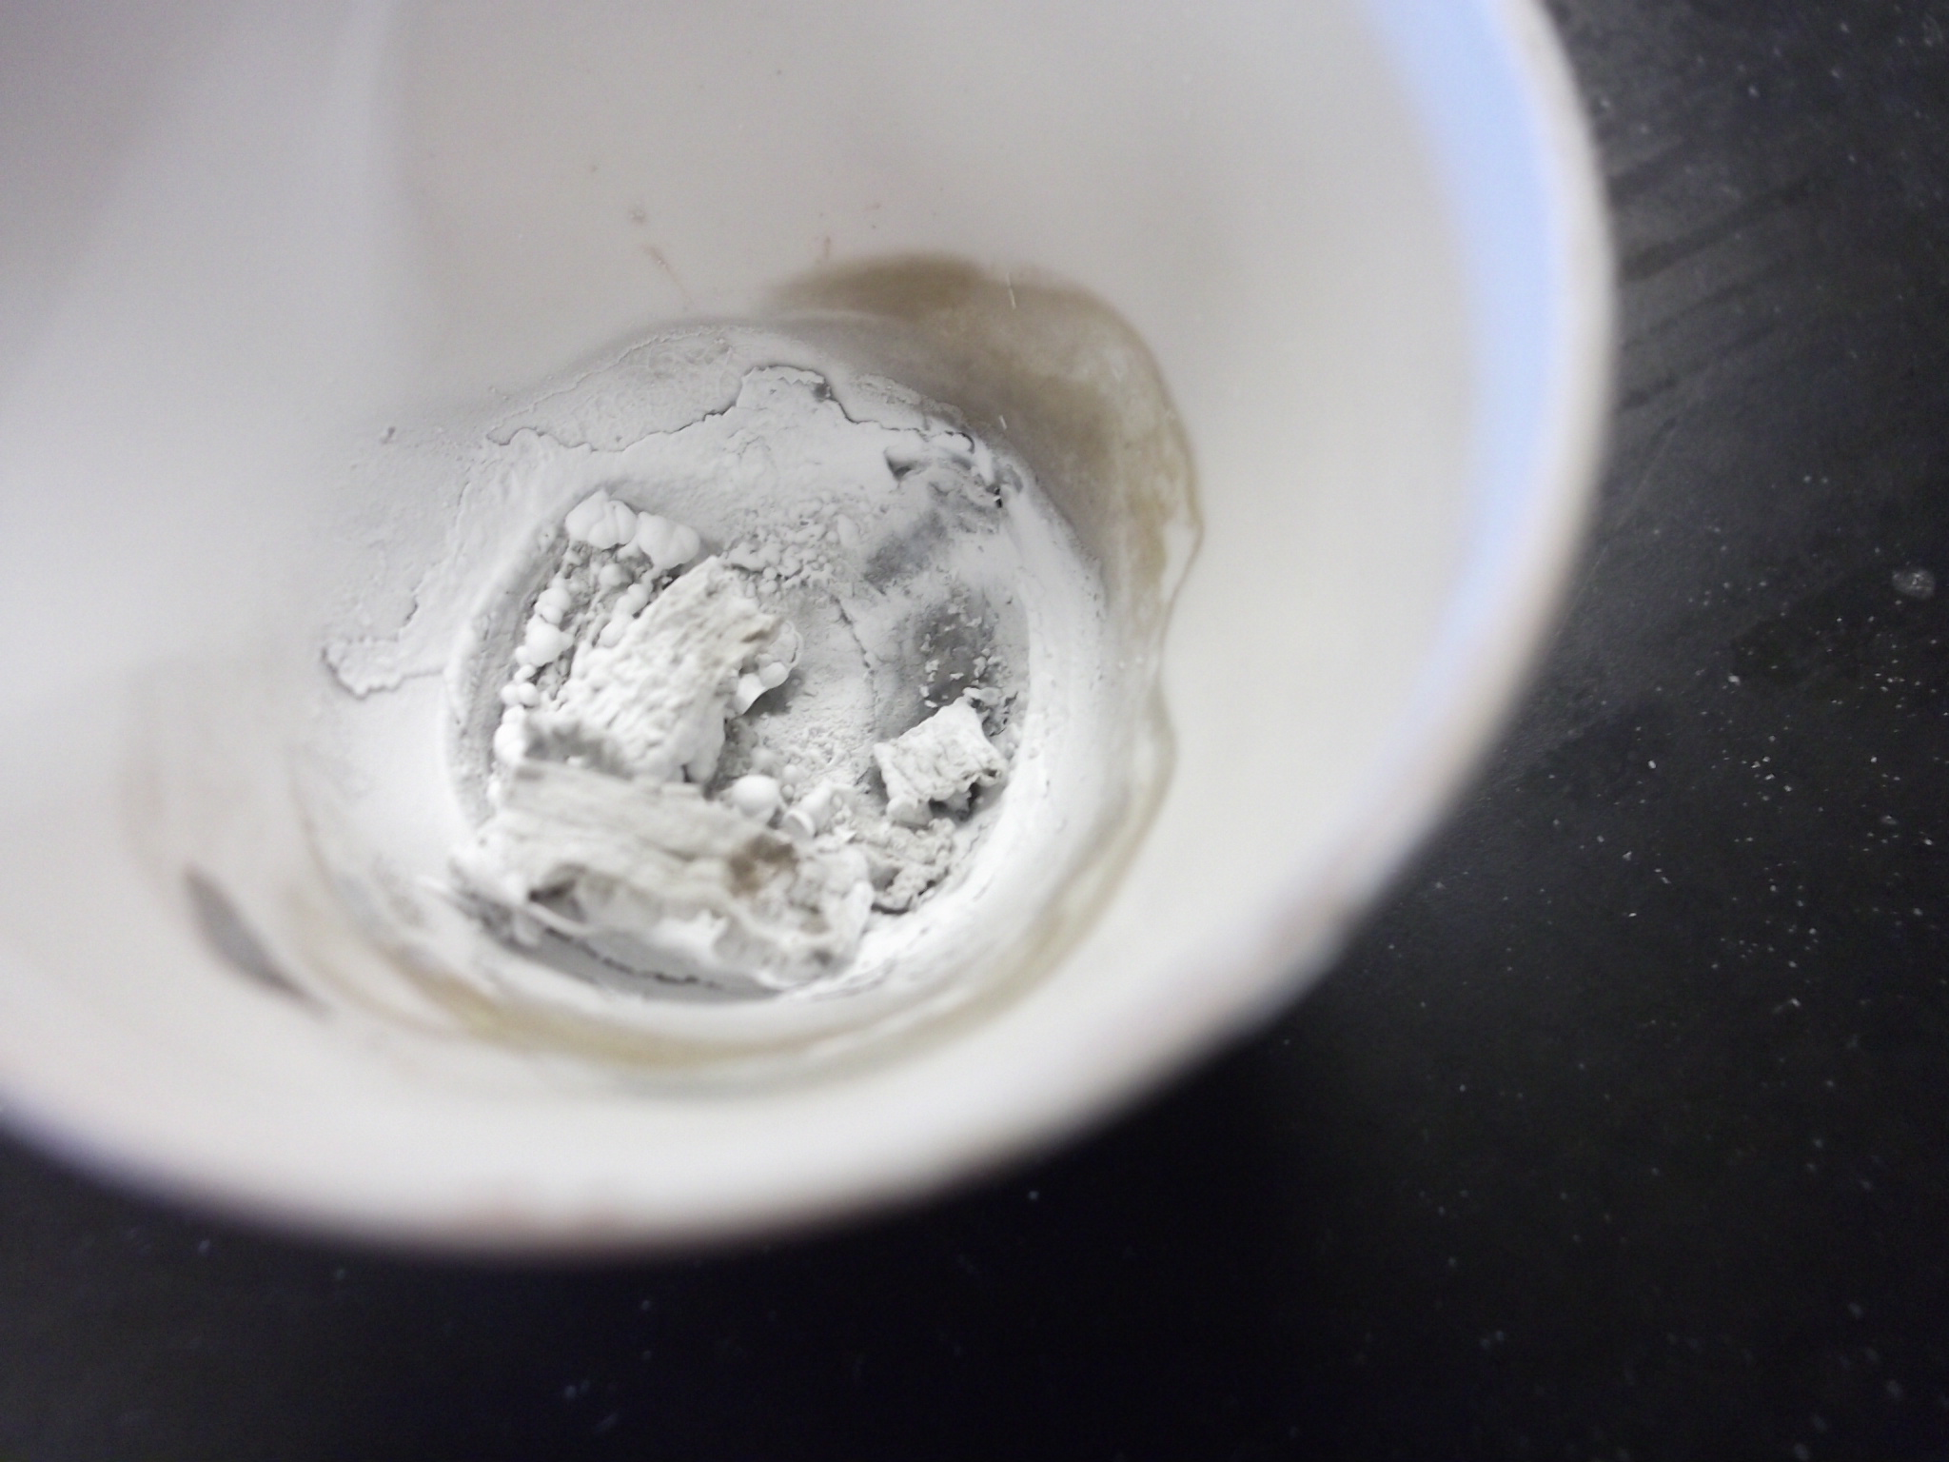
Empirical Formula Lab report

Slide 59
Lab Report Writing
C-E-R
Bring your reader along
Report ALL of your calculations and data
Sample lab reports will be posted on our class website by the end of the day.
Questions?

Slide 60
Day 10 Bellwork
Which 7 elements exist has diatomics in nature (i.e. when they are not bonded to anything else)?

Slide 61
Breakdown of Chemical Equations
Nitrogen plus Hydrogen yields Ammonia

Slide 62
Breakdown of Chemical Equations
Nitrogen plus Hydrogen yields Ammonia
_N₂ (g) + 3H₂ (g) → 2NH₃ (g)

Slide 63
Another way we can say this…..
_N₂ (g) + 3H₂ (g) → 2NH₃ (g)
Nitrogen reacts with Hydrogen to produce Ammonia

Slide 64
Breakdown of Chemical Reaction Equations
Nitrogen reacting with Hydrogen yields Ammonia
_N₂ (g) + 3H₂ (g) → 2NH₃ (g)
Reactants
Products

Slide 65
Breakdown of Chemical Reaction Equations
Nitrogen reacting with Hydrogen yields Ammonia
_N₂ (g) + 3H₂ (g) → 2NH₃ (g)
NOT “equals”

Slide 66
Breakdown of Chemical Reaction Equations
_N₂ (g) + 3H₂ (g) → 2NH₃ (g)
Coefficients:
# MOLECULES needed to react with the other molecules
OR
# MOLES of each molecule needed to react with the appropriate moles of other molecules
(just like our subscripts; except mole ratio of molecules instead of atoms)

Slide 67
Breakdown of Chemical Reaction Equations
Nitrogen reacts with Hydrogen yields Ammonia
_N₂ (g) + 3H₂ (g) → 2NH₃ (g)
State of matter (s, l, g, aq)

Slide 68
*Law of conservation of matter : Matter (atoms) is neither created nor destroyed during any chemical reaction
We must balance chemical equations to be equal on both sides. Let’s relate this to a sandwich…
Then…
We’ll do some practice problems in your homework packet.
Notes:
Follow with creating a chemical equation using the contents of a sandwich

Slide 69
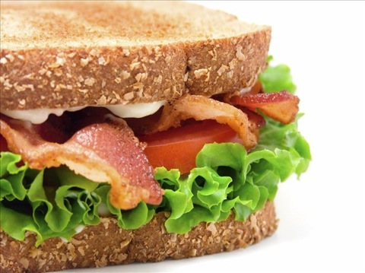
What is the balanced equation for building this sandwich?

Slide 70
The process of balancing equations
Determine chemical formulas of products and reactants.
Balance elements that occur the fewest times first.
  Always leave oxygen and hydrogen for last.
  When only oxygen and hydrogen are left, balance the one that appears in the fewest places first.
Notes:
Subscripts may never be changes when balancing, Only coefficients may be changed to balance equations
Changing coefficients changes the amount of substance and not the identity of the substance.

Slide 71
Examples of balancing process
Balance this skeleton equation:
__ H₂O₂ → __ H₂ + __ O₂
Write out the chemical equation and balance it:
Iron reacts with oxygen to produce iron (III) oxide

Slide 72
Balance the following equations
__FeS + __HCl → __FeCl₂ + H₂S
__KClO₃ → __KCl + __O₂
__H₂S + __O₂ → __SO₂ +__H₂O
__Na₂O₂ + __H₂O → __O₂ + __NaOH

Slide 73
When the oxygen just won’t balance
Sometimes oxygen, O₂, can be difficult to balance, especially when different numbers of moles of oxygen are present on either side of the reaction.
__H₂S + __O₂ → __SO₂ +__H₂O
Solution: Use fractions and then a multiplier to get lowest whole number ratio.

Slide 74
When the oxygen just won’t balance
Solution: Use fractions and then a multiplier to get lowest whole number ratio.
After you’ve balanced everything else….
Split the diatomic oxygen into a single atom (just for now!) with a fraction where the number of the top is equal to the number of oxygens on the other side of the reaction.
Now, multiply across by 2 to get whole numbers:
1 H₂S + 3/2 O₂ → 1 SO₂ + 1 H₂O
2 H₂S + 3 O₂ → 2 SO₂ + 2 H₂O

Slide 75
Day 10: Types of reactions

Slide 76
Day 12 bellwork: Identify the reaction type
1. First day of school:
Zn + HCl → ZnCl + H₂
2. Today’s demo:
Zn + S → ZnS

Slide 77
What holds atoms together?
Electrons of one atoms are attracted to protons of another atom.
Electron clouds overlap
Energy must be added even if it is an exothermic reaction.
This energy is referred to as activation energy

Slide 78
Energy Changes
Energy must be absorbed to break bonds
Energy is released when bonds formed
The difference in energy between breaking bonds and making bonds is the Enthalpy of Reaction (Heat of Reaction) which determines if the reaction is exothermic or endothermic

Slide 79
Combustion
O₂ combines with elements
exothermic, produce heat & light
makes oxides
Examples
S₈(s) + 8 O₂(g) → 8SO₂(g) + light
CH₄(g) + 2O₂(g)→ CO₂(g) + 2H₂0(l) + heat/light

Slide 80
Combustion Reactions
Hydrocarbons burned in presence of O₂ (air) always produce CO₂+ H₂O.
C₆H₁₂O₆ + 6 O₂ ^{energy} 6 CO₂ + 6 H₂O
  What is the name for this reaction?
Notes:
Aerobic cellular respirations
Mitochondria
Enzymes decrease the activation energy of the reaction
The energy is put into ATP and NADH.
Incomplete combustion results in CO and fine carbon particles called soot.

Slide 81

Combination (synthesis)
Combination
  Two reactants produce a more complex product.
  When this occurs between a metal and a nonmetal the product is an ionic solid.
Notes:
Many elements react with one another to form compounds

Slide 82
Synthesis Examples
Li + Br₂ →
Zn + S →

Slide 83
Synthesis
polymerization: is a chain of synthesis reactions adding on to each other.
I.E. making of DNA, plastics, proteins
Tend to be exothermic

Slide 84
Decomposition reactions
A single reactant breaks apart to form two or more products.
Metal carbonates decompose when heated to form metal oxides and carbon dioxide.
Usually endothermic
Notes:
NaN₃ use to expand air bags in cars.
Impact ignites detonator, Na_{(s)} and N_{2(g)} are produced.

Slide 85
Single Displacement
Redox reactions – there is a transfer of e-
K + HOH → H₂ + KOH
Zn + 2HCl → ZnCl₂ + H₂

Slide 86
Single displacement reaction
Reaction of a metal with either an acid or metal salt follows general form of:
A + BX AX +B
Oxidation of metals by acids and salts
Notes:
Combustion reactions are a form of redox reaction.
Elemental oxygen is converted to compounds of oxygen.

Slide 87
Double displacement
Aka Exchange Reactions
aka Metathesis reactions
aka Double replacement

Slide 88
Summary
A + B → AB Synthesis
AB → A + B Decomposition
AB + O₂ → A_{x}O + B_{y}O Combustion
AB + C → CB + A Single Displacement
AB + CD → CB + AD Double Displacement

Slide 89
Questions to ask yourself when identifying reactions:
1.) Combustion: is O₂ a reactant?
2.) Synthesis: do my reactants combine to produce 1 product?
3.) Decomposition: does my reactant break apart into more than 1 product?
4.) Single displacement:
  Are the reactants a compound and a single element?
  Does the single element replace one of the elements in the compound?
5.) Double displacement:
  Do I have 2 compounds as reactants?
  Is there an exchange of elements between the 2 compounds?

Slide 90
20) Identify Reactions
2K + 2H₂O → H₂ + 2KOH
A.) Synthesis
B.) Decomposition
C.) Combustion
D.) Single Displacement
E.) Double Displacement

Slide 91
21) Identify Reactions
BaCl₂ + Na₂SO₄ → 2NaCl + BaSO₄
A.) Synthesis
B.) Decomposition
C.) Combustion
D.) Single Displacement
E.) Double Displacement

Slide 92
22) Identify Reactions
2SO₂ + O₂ → 2SO₃
A.) Synthesis
B.) Decomposition
C.) Combustion
D.) Single Displacement
E.) Double Displacement

Slide 93
23) Identify Reactions
C₆H₆ + 15/2 O₂ → 6CO₂ + 3H₂O
A.) Synthesis
B.) Decomposition
C.) Combustion
D.) Single Displacement
E.) Double Displacement

Slide 94
25) Identify Reactions
2KClO₃ → 2KCl + 3O₂
A.) Synthesis
B.) Decomposition
C.) Combustion
D.) Single Displacement
E.) Double Displacement

Slide 95
26) Identify Reactions
SO₃ + H₂O → H₂SO₄
A.) Synthesis
B.) Decomposition
C.) Combustion
D.) Single Displacement
E.) Double Displacement

Slide 97
Day 13: Aqueous Solutions
Solubility rules revisited
Net Ionic Equations

Slide 98
Day 13 Bellwork
In the following double displacement reactions, what do you predict your products to be?
Sodium iodide reacted with silver nitrate yields

Slide 99
Time table for Unit 6: day 1
Chapter 10
Chapter 10
Chapter 11
Chapter 11

Slide 100
Agenda for the day
3 min: Bellwork
15 min: Writing net ionic equations
8 min: Solubility rules song + bracket
10 min: Practice problems
25 min: Reading quiz
2 min: Wrap Up and Announcements

Slide 101
Precipitation Reactions
Reactions that result in an insoluble product.
Insoluble:
  Water molecules cannot
  overcome the attraction
  between the ions.

Slide 102
Solubility of Ionic Compounds
All acetates and nitrates are soluble in water.
All ionic compounds of alkali metals and ammonium are soluble.
See table page 111****
Notes:
Cl, Br, I, soluble accept Hg, Ag, Pb.
Sulfate: soluble accept Hg, Pb, Sr, Ba
Insoluble:
CO₃ , PO₄(other than alkali metal and NH₄)
OH accept Ca, Sr, Ba

Slide 103
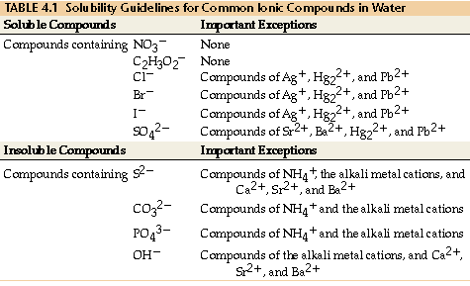
SONG

Slide 104
Equation Types
Molecular
Complete Ionic
Net ionic equation
Notes:
Molecular equations:
Shows complete chemical formulas of reactants and products. Does not show ionic character.
Complete ionic equation:
Show all strong electrolytes as ions.
Net ionic equation:
Show only those ions involved in the reaction.

Slide 105
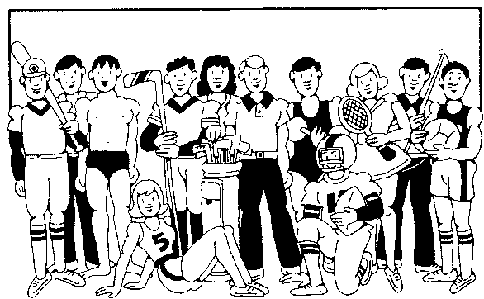
Ionic Equations
Those ions that appear on both sides of a complete ionic equation are known as Spectator Ions.
Net ionic equations do not include spectator ions.
Notes:
Spectator Ions do not play a role in the reaction.

Slide 106
Exchange Reactions
Double displacement
Double replacement

Slide 107
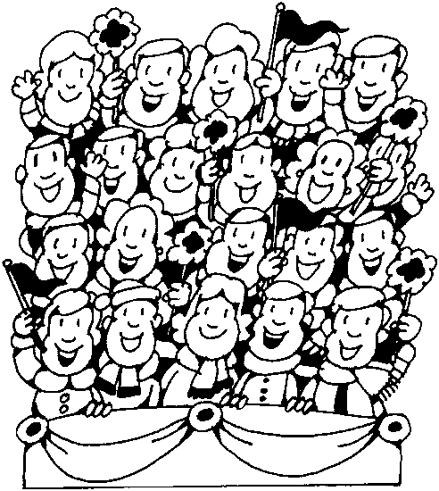
Writing Net Ionic Equations
Write a balanced molecular equation.
Rewrite the equation showing ions of strong electrolytes only (i.e. soluble in water).
Identify and cancel all spectator ions.

Slide 108
Practice Problems
Precipitation reaction between solutions of potassium bromide and silver acetate
Precipitation reaction between barium chloride and sodium sulfate

Slide 109
Unit 6b test Review Session
Chem B
4/14/2013

Slide 110
REVIEW SESSION!
Today’s order of events:
Students will be split up into groups of 4 or 5.
Group member roles will be chosen.
Each group will work through 3 preassigned stations (15 minutes each).
Prepare for tomorrow’s lab (10 min)

Slide 111
Roles and tasks
Group members will decide among themselves who will take on each role. Write the group member’s name under that task on the “Station” card:
Facilitator: This group member gets discussion moving and keeps it moving, often by asking the other group members questions, sometimes about what they've just been saying. It is this group member’s job to make sure that everyone has a chance to speak and to contribute to the group’s work.
Recorder: This person will create the group’s poster with the support of their group members.
Spokesperson/Press Secretary/Webmaster: This group member will summarize the group's progress and findings to the instructor and to other groups.
Calculator/Checker(s): The group member(s) who perform the calculations and double checks that the group has answered what the question asked
  **If you have 5 members in your group, you will have the benefit of 2 calculators/checkers!

Slide 112
Station Assignments
Station | Topic | Session 1 | Session 2 | Session 3
A | Naming and Activity series Balancing | Group 1 | Group 2 | Group 3
B | Types of reactions | Group 2 | Group 3 | Group 4
C | Solubility | Group 3 | Group 4 | Group 5
D | Solubility | Group 6 | Group 1 | Group 2
E | Naming and Activity Series Balancing | Group 4 | Group 5 | Group 6
F | Types of reactions | Group 5 | Group 6 | Group 1

Slide 113
Activity Series of Metals
Activity Series of Metals
 | Name | Symbol
 | Lithium Potassium Calcium Sodium Magnesium Aluminum Zinc Iron Lead (Hydrogen) Copper Mercury Silver | Li K Ca Na Mg Al Zn Fe Pb (H) Cu Hg Ag
Decreasing reactivity
http://group.chem.iastate.edu/Greenbowe/sections/projectfolder/flashfiles/redox/home.html

